Slide 1
Mk with α=0.05 & illustrated branch durations
10
0–
0–
0–
11
0–
1
2
3
4
Additive

Slide 2
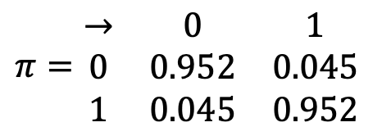
Mk with α=0.05 & illustrated branch durations
10
0–
0–
0–
11
0–
1
0.045 | 0.045
0.045 | 0.045
2
3
$$π=\begin{matrix}→ & 0 & 1 \\ 0 & 0.952 & 0.045 \\ 1 & 0.045 & 0.952\end{matrix}$$
4
Marginals: are straightforward for Independent.

Slide 3
Mk with α=0.05 & illustrated branch durations
10
0–
0–
0–
11
0–
1
0.045 | 0.045
0.045 | 0.045
2
0.952 | 0.048
0.048 | 0.952
3
$$π=\begin{matrix}→ & 0 & 1 \\ 0 & 0.952 & 0.045 \\ 1 & 0.045 & 0.952\end{matrix}$$
4
For Dependent character, P[change/stasis] reflects only one branch.

Slide 4
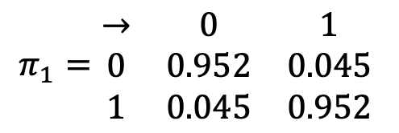
Mk with α=0.05 & illustrated branch durations
10
0–
0–
0–
11
0–
1
0.045 | 0.045
0.045 | 0.045
2
0.952 | 0.048
0.048 | 0.952
0.041 | 4.1×10⁻³
0.041 | 4.1×10⁻³
3
0.909 | 0.091
0.091 | 0.909
$$π_{1}=\begin{matrix}→ & 0 & 1 \\ 0 & 0.952 & 0.045 \\ 1 & 0.045 & 0.952\end{matrix}$$
1.6×10⁻³ | 3.4×10⁻⁵
4
For the dependent character, marginals again equal to transition probabilities for just 1 branch.

Slide 5
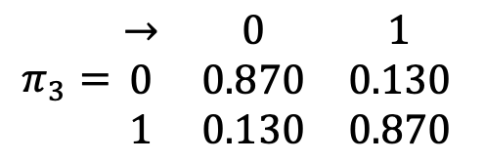
Mk with α=0.05 & illustrated branch durations
10
0–
0–
0–
11
0–
1
0.045 | 0.045
0.045 | 0.045
2
0.952 | 0.048
0.048 | 0.952
0.041 | 4.1×10⁻³
0.041 | 4.1×10⁻³
3
0.909 | 0.091
0.091 | 0.909
$$π_{1}=\begin{matrix}→ & 0 & 1 \\ 0 & 0.952 & 0.045 \\ 1 & 0.045 & 0.952\end{matrix}$$
1.6×10⁻³ | 3.4×10⁻⁵
$$π_{3}=\begin{matrix}→ & 0 & 1 \\ 0 & 0.870 & 0.130 \\ 1 & 0.130 & 0.870\end{matrix}$$
4
0.113 | 0.113
Dependent now reflects going from either 0 or 1 to 0 & 1 over 3 myr.

Slide 6
Mk with α=0.05 & illustrated branch durations
10
0–
0–
0–
11
0–
1
0.045 | 0.045
0.045 | 0.045
2
0.952 | 0.048
0.048 | 0.952
0.041 | 4.1×10⁻³
0.041 | 4.1×10⁻³
3
0.909 | 0.091
0.091 | 0.909
1.6×10⁻³ | 3.4×10⁻⁵
4
0.113 | 0.113
P[absent] = 0.978;
P[present & 0] = 0.011.

Slide 7
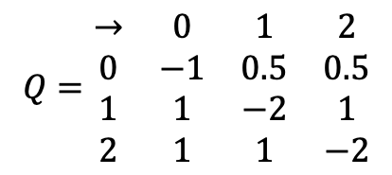
Mk with α=0.05 & illustrated branch durations
10
0–
0–
0–
11
0–
1
0
0
0
2
0
1
2
0.045 | 0.045
0.045 | 0.045
3
0.045 | 0.045
0.045 | 0.045
$$Q=\begin{matrix}→ & 0 & 1 & 2 \\ 0 & −1 & 0.5 & 0.5 \\ 1 & 1 & −2 & 1 \\ 2 & 1 & 1 & −2\end{matrix}$$
4
0.045 | 0.045
Multistate Version.
Binary for Absent; Trinary* for Dependents.

Slide 8
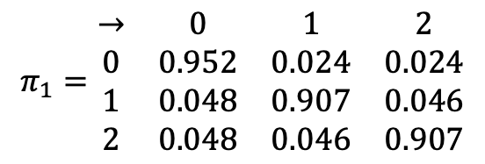
Mk with α=0.05 & illustrated branch durations
10
0–
0–
0–
11
0–
1
0
0
0
2
0
1
2
0.023 | 0.043 | 2.2×10⁻³
0.045 | 0.045
3
0.045 | 0.045
0.045 | 0.045
$$π_{1}=\begin{matrix}→ & 0 & 1 & 2 \\ 0 & 0.952 & 0.024 & 0.024 \\ 1 & 0.048 & 0.907 & 0.046 \\ 2 & 0.048 & 0.046 & 0.907\end{matrix}$$
4
0.045 | 0.045
Multistate Version.
Binary for Absent; Trinary* for Dependents.

Slide 9
Mk with α=0.05 & illustrated branch durations
10
0–
0–
0–
11
0–
1
0.045 | 0.045
2
0.952 | 0.048
3
$$π=\begin{matrix}→ & 0 & 1 \\ 0 & 0.952 & 0.045 \\ 1 & 0.045 & 0.952\end{matrix}$$
4
P[absent] = 0.5.
P[present & 1] = 0.478

Slide 10
Mk with α=0.05 & illustrated branch durations
10
0–
0–
0–
11
0–
1
0
0
0
2
0
1
2
0.023 | 0.043 | 2.2×10⁻³
0.045 | 0.045
3
0.045 | 0.045
0.045 | 0.045
$$π_{1}=\begin{matrix}→ & 0 & 1 & 2 \\ 0 & 0.952 & 0.024 & 0.024 \\ 1 & 0.048 & 0.907 & 0.046 \\ 2 & 0.048 & 0.046 & 0.907\end{matrix}$$
4
0.045 | 0.045
P[absent] = 0.333
P[present & 1] = 0.635

Slide 11
Mk with α=0.05 & illustrated branch durations
10
0–
0–
0–
11
0–
1
0
0
0
2
0
1
2
0.023 | 0.043 | 2.2×10⁻³
0.023 | 2.2×10⁻³ | 0.043
3
0.021 | 3.7×10⁻³ | 4.5×10⁻⁴
0.021 | 4.5×10⁻⁴ | 3.7×10⁻³
$$π_{1}=\begin{matrix}→ & 0 & 1 & 2 \\ 0 & 0.952 & 0.024 & 0.024 \\ 1 & 0.048 & 0.907 & 0.046 \\ 2 & 0.048 & 0.046 & 0.907\end{matrix}$$
4
0.045 | 0.045
P[absent] = 0.833
P[present & 1] = 0.148

Slide 12
Mk with α=0.05 & illustrated branch durations
10
0–
0–
0–
11
0–
1
0
0
0
2
0
1
2
0.023 | 0.043 | 2.2×10⁻³
0.023 | 2.2×10⁻³ | 0.043
3
0.021 | 3.7×10⁻³ | 4.5×10⁻⁴
0.021 | 4.5×10⁻⁴ | 3.7×10⁻³
$$π_{1}=\begin{matrix}→ & 0 & 1 & 2 \\ 0 & 0.952 & 0.024 & 0.024 \\ 1 & 0.048 & 0.907 & 0.046 \\ 2 & 0.048 & 0.046 & 0.907\end{matrix}$$
4
3.9×10⁻⁴ | 6.7×10⁻⁶ | 6.7×10⁻⁶
P[absent] = 0.967;
P[present & 1 or 2] = 0.017

Slide 13
Mk with α=0.05 & illustrated branch durations
10
0–
0–
0–
11
0–
1
0.045 | 0.045
0.045 | 0.045
2
0.952 | 0.048
0.048 | 0.952
0.041 | 4.1×10-3
0.041 | 4.1×10-3
3
0.909 | 0.091
0.091 | 0.909
1.6×10⁻³ | 3.4×10⁻⁵
4
0.113 | 0.113
P[absent] = 0.978;
P[present & 0] = 0.011.

